Slide 1


Synopsis Presentation on DealOye: An online platform for buying and selling study materials using web development technologies
Guided By: Presented By:
Prof. Shahida Khan Pavendra Singh Rajput (0827IT211081)
Sanjna Yadav (0827IT211104)
Soni Rathore (0827IT211112)
Vidhi Goyal (0827IT211128)
Vikas Agrawal (0827IT21130)

Slide 2
Contents
Introduction
1.1 Overview
1.2 Purpose
Literature Review
Problem Statement
Proposed Solution
Objectives
Theoretical Analysis
6.1 Block Diagram
6.2 Hardware Requirements
6.3 Software Requirements
Applications
REFERENCES

Slide 3
1. Introduction
1.1 Overview
Dealoye is a web-based platform that allows college students to buy, sell, and exchange academic and personal items within their community.
It includes an OTP-based login/signup, a wish list, product updates, and personalized dashboards for a convenient experience.
The platform offers a dynamic homepage for featured products, a buy page for browsing, and a sell page for managing listings.
1.2 Purpose
The purpose of the Dealoye project is to create a dedicated platform for students to buy, sell, and exchange items within their college community.
This marketplace addresses the need for an easy and reliable way to access second-hand products, allowing students to save money and reduce waste.

Slide 4
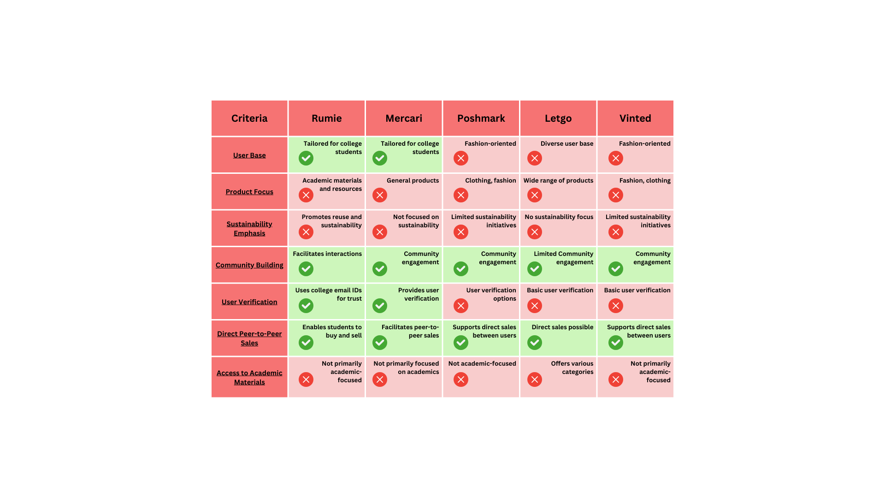
2. Literature Review

Slide 5
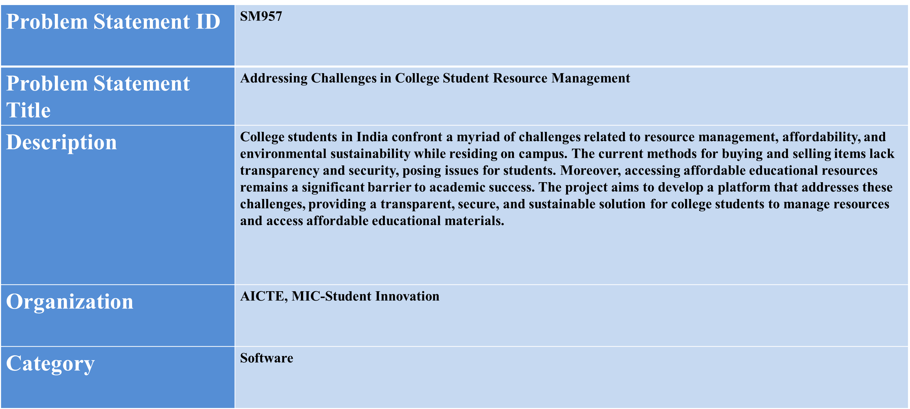
3. Problem Statement
5

Slide 6
4. Proposed Solution
User Authentication:
Implemented a login/signup system with OTP verification to ensure secure access.
Product Listings:
Created a feature to display featured products on the homepage for easy browsing.
Search Functionality:
Users can search for specific products, enhancing user experience.
Buy Section:
Listed items available for purchase from other students, with "Wishlist" and "Contact" buttons for easy engagement.
Sell Section:
Sellers can manage their listings, mark availability, and remove items directly.
Requirements Section:
Users can post their product requirements and view others' needs along with contact details
.
Dashboard:
Displays a summary of user-specific actions—wishlist, items for sale, and posted requirements.
Tech Stack:
Built using HTML, CSS, JavaScript, Node.js, Express.js, MongoDB, and API integration for seamless functionality.

Slide 7
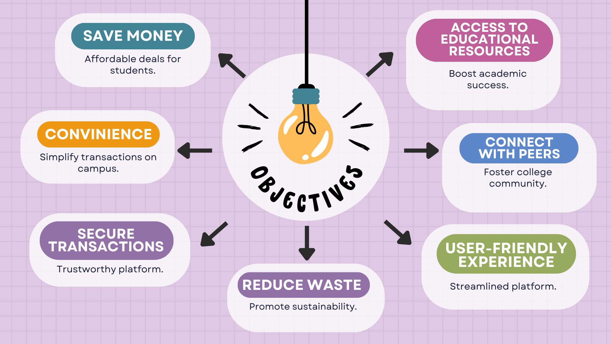
5. Objectives

Slide 8
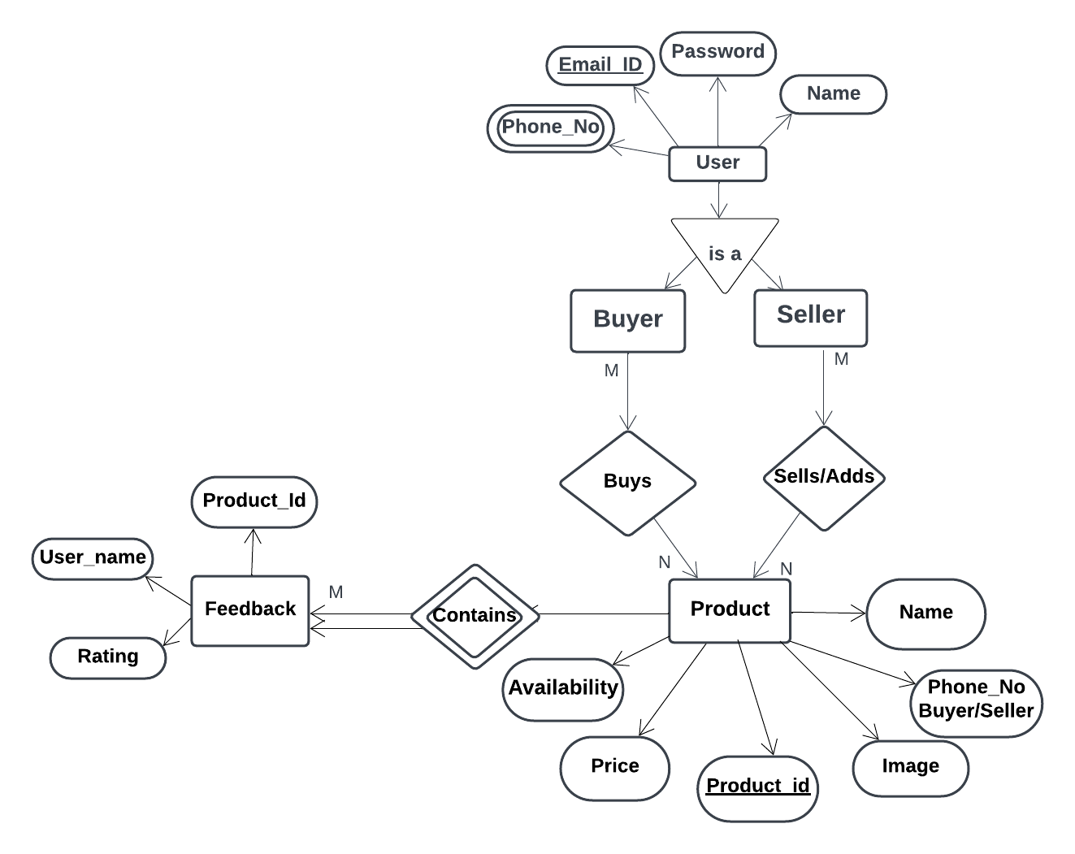
6. Theoretical Analysis

Slide 9
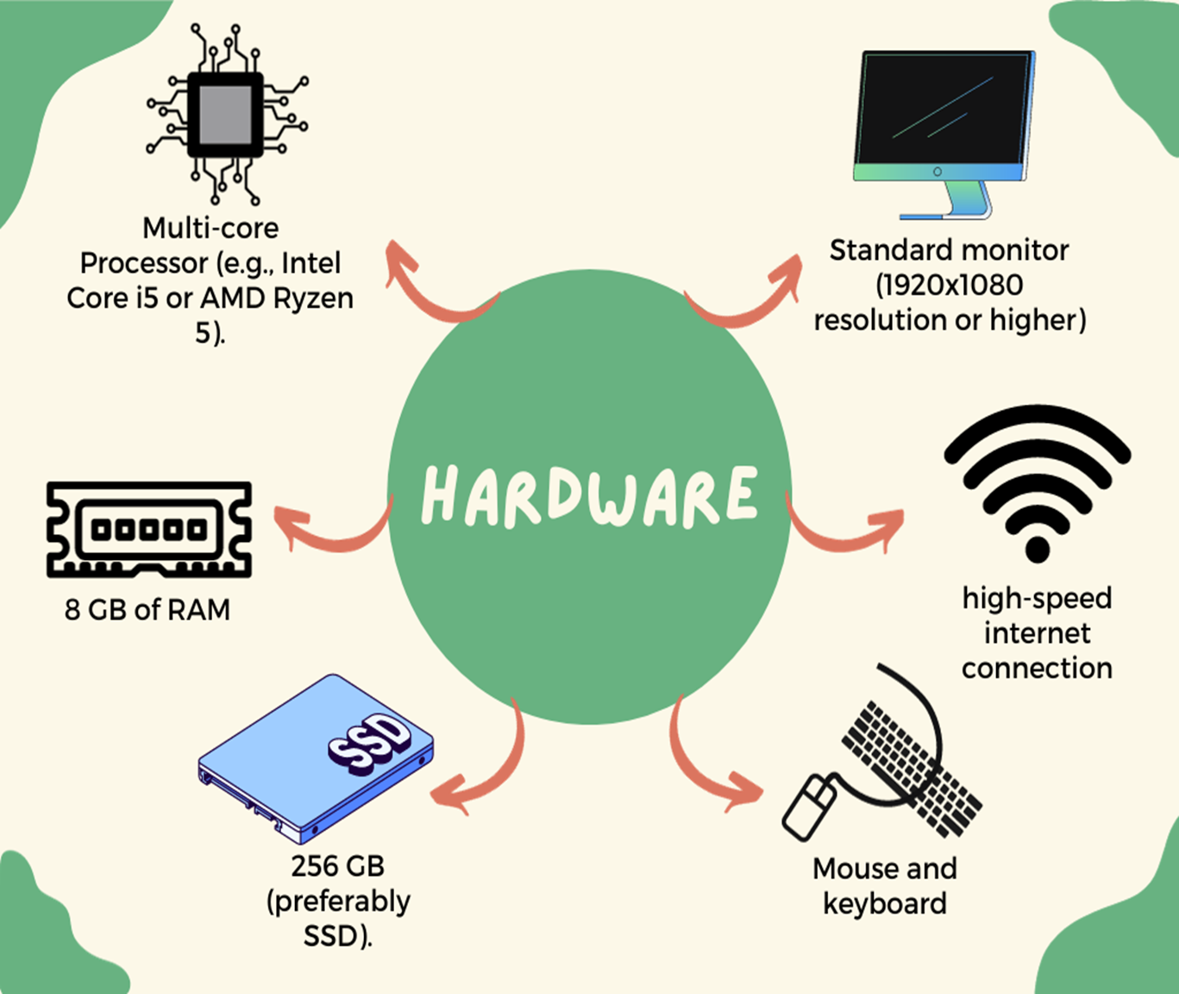
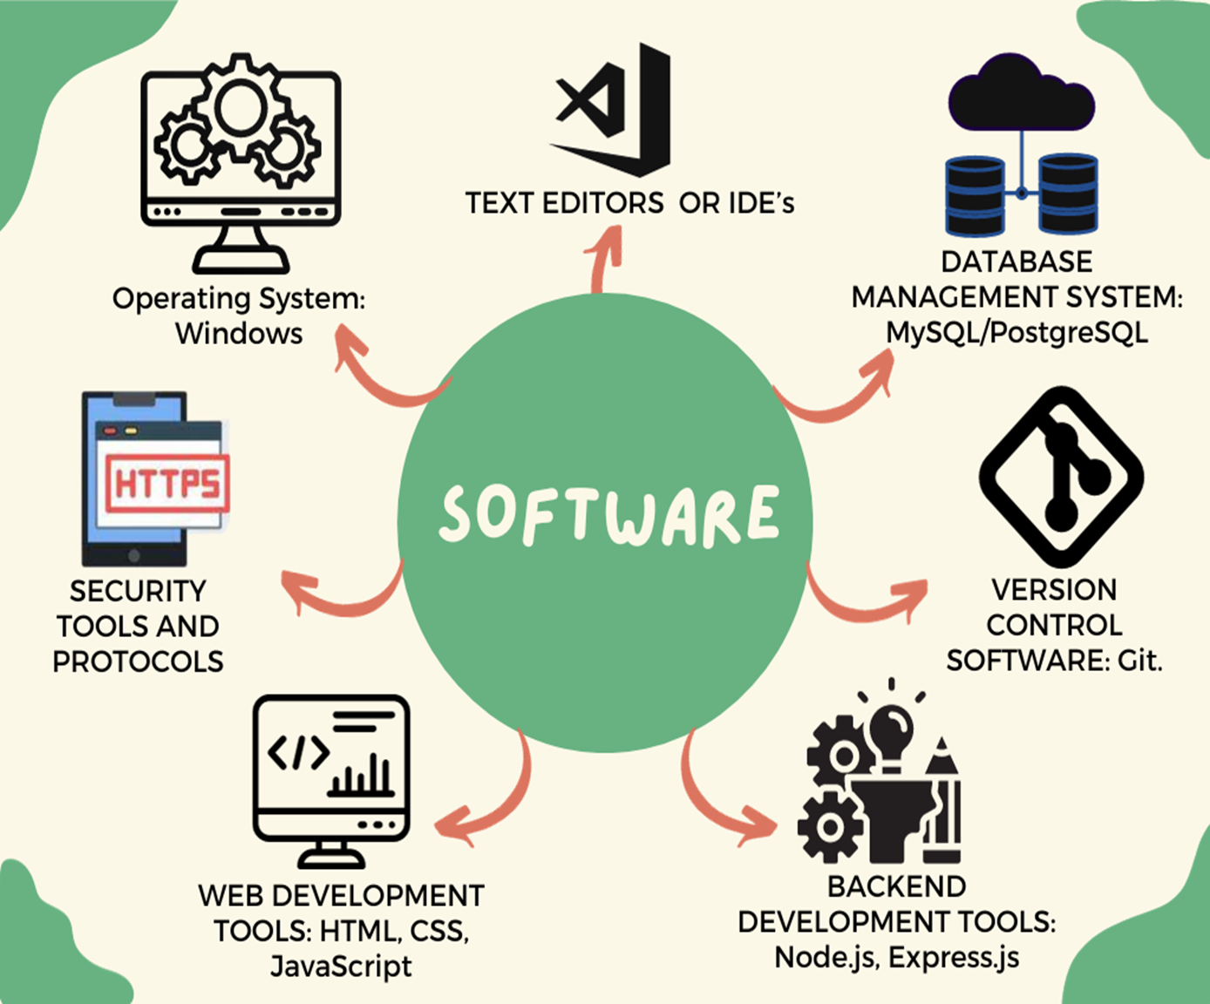
6. Theoretical Analysis

Slide 10
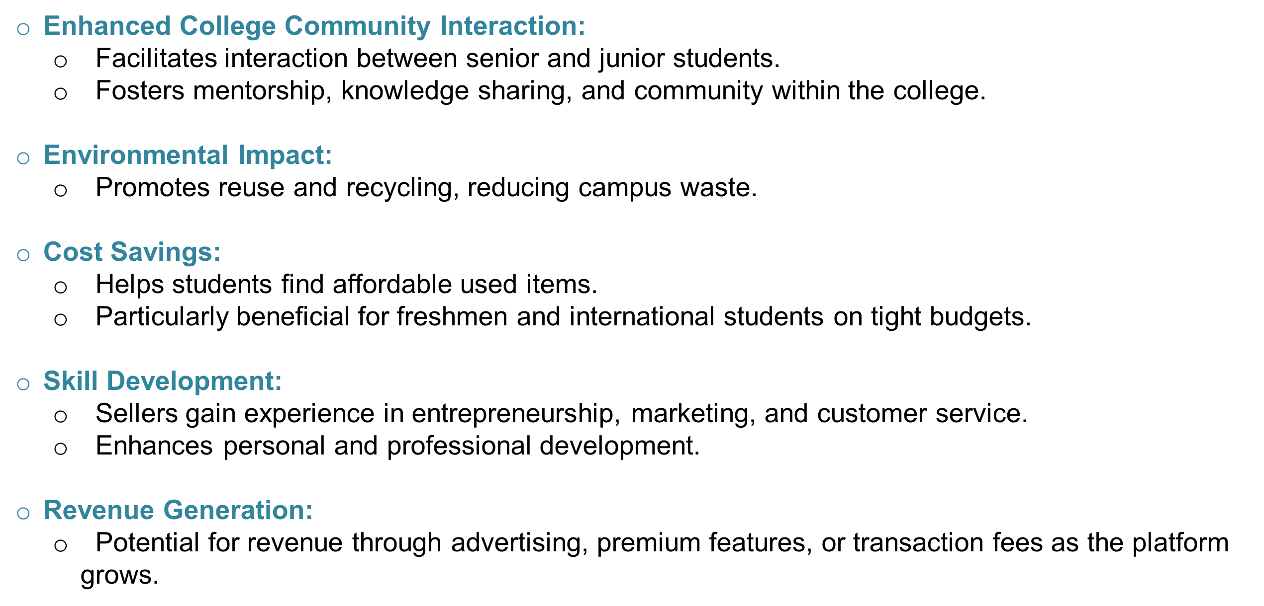
Applications

Slide 11
GitHub Link
https://github.com/vidhigoyal619/Dealoye_new
https://github.com/sonira17/Dealoye_Repo
https://github.com/vikas/Dealoye
https://github.com/pavendra/Dealoye_rep
https://github.com/sanjana/DealOye

Slide 12
REFERENCES
Ecommerce Development: YouTube Playlist - A comprehensive playlist on YouTube covering various aspects of ecommerce development.
Web Development Insights: Medium Articles - A collection of articles on Medium related to web development trends and practices.
Mercari: Mercari is a selling app that facilitates the buying and selling of various items with no deductions from the sale. For more details, visit Mercari.
● Poshmark: Poshmark is a platform focused on buying and selling fashion items. It features a professional environment but imposes fees on low-value sales. For more information, check out: Poshmark.

Slide 13
Thank You
Queries ?

